Slide 1

STEP COUNTER AND PEDOMETER
Anil Rongala – 2293848

Slide 2

OBJECTIVE
The primary objective of the project is to develop a step counter and pedometer system. This system will utilize an accelerometer to detect and count the number of steps taken by the user in real-time. Using number of steps, distance travelled and calorie burnt is also found.
The project is developed using STM32L4 Discovery kit and LSM6DSL accelerometer.

Slide 3

COMPONENTS USED
STM32L4 Discovery Kit
STM32CUBE IDE (Software)
LSM6DSL Accelerometer
1.8 inch SPI TFT LCD Display module

Slide 4
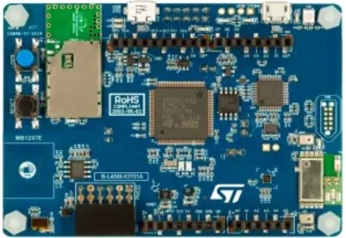
STM32L4 Discovery Kit:
The STM32L4 Discovery Kit is a development board featuring STM32L4 series microcontrollers, suitable for various embedded applications and commonly used with STM32Cube IDE.
It provides on-board components like LEDs, buttons, and expansion headers for prototyping and interfaces well with sensors like the LSM6DSL accelerometer, temperature sensor, magnetometer, etc.

Slide 5
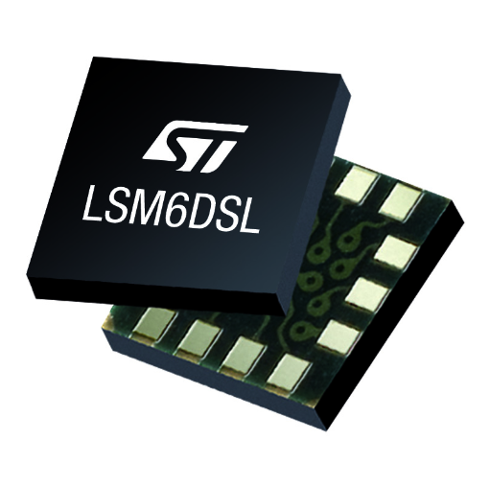
LSM6DSL Accelerometer:
The LSM6DSL is a MEMS accelerometer and gyroscope sensor, widely used for motion sensing applications, offering high accuracy and programmable measurement ranges.
It can be easily interfaced with microcontrollers like those on the STM32L4 Discovery Kit for capturing and processing motion data.

Slide 6
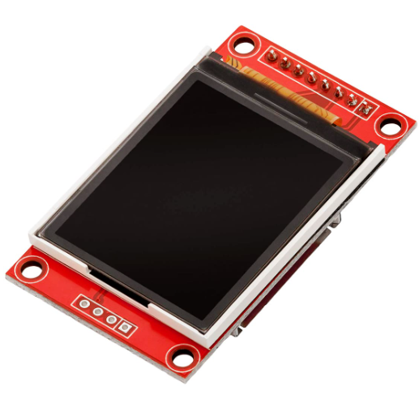
TFT Display Module:
The 1.8-inch SPI TFT LCD module combines a compact design with vibrant graphics, ideal for projects requiring a small form factor without compromising visual quality.
With an SPI interface, the 1.8-inch TFT LCD effortlessly integrates into diverse electronics. Its small size and SPI connectivity make it an optimal choice for projects requiring both compact design and efficient communication.

Slide 7
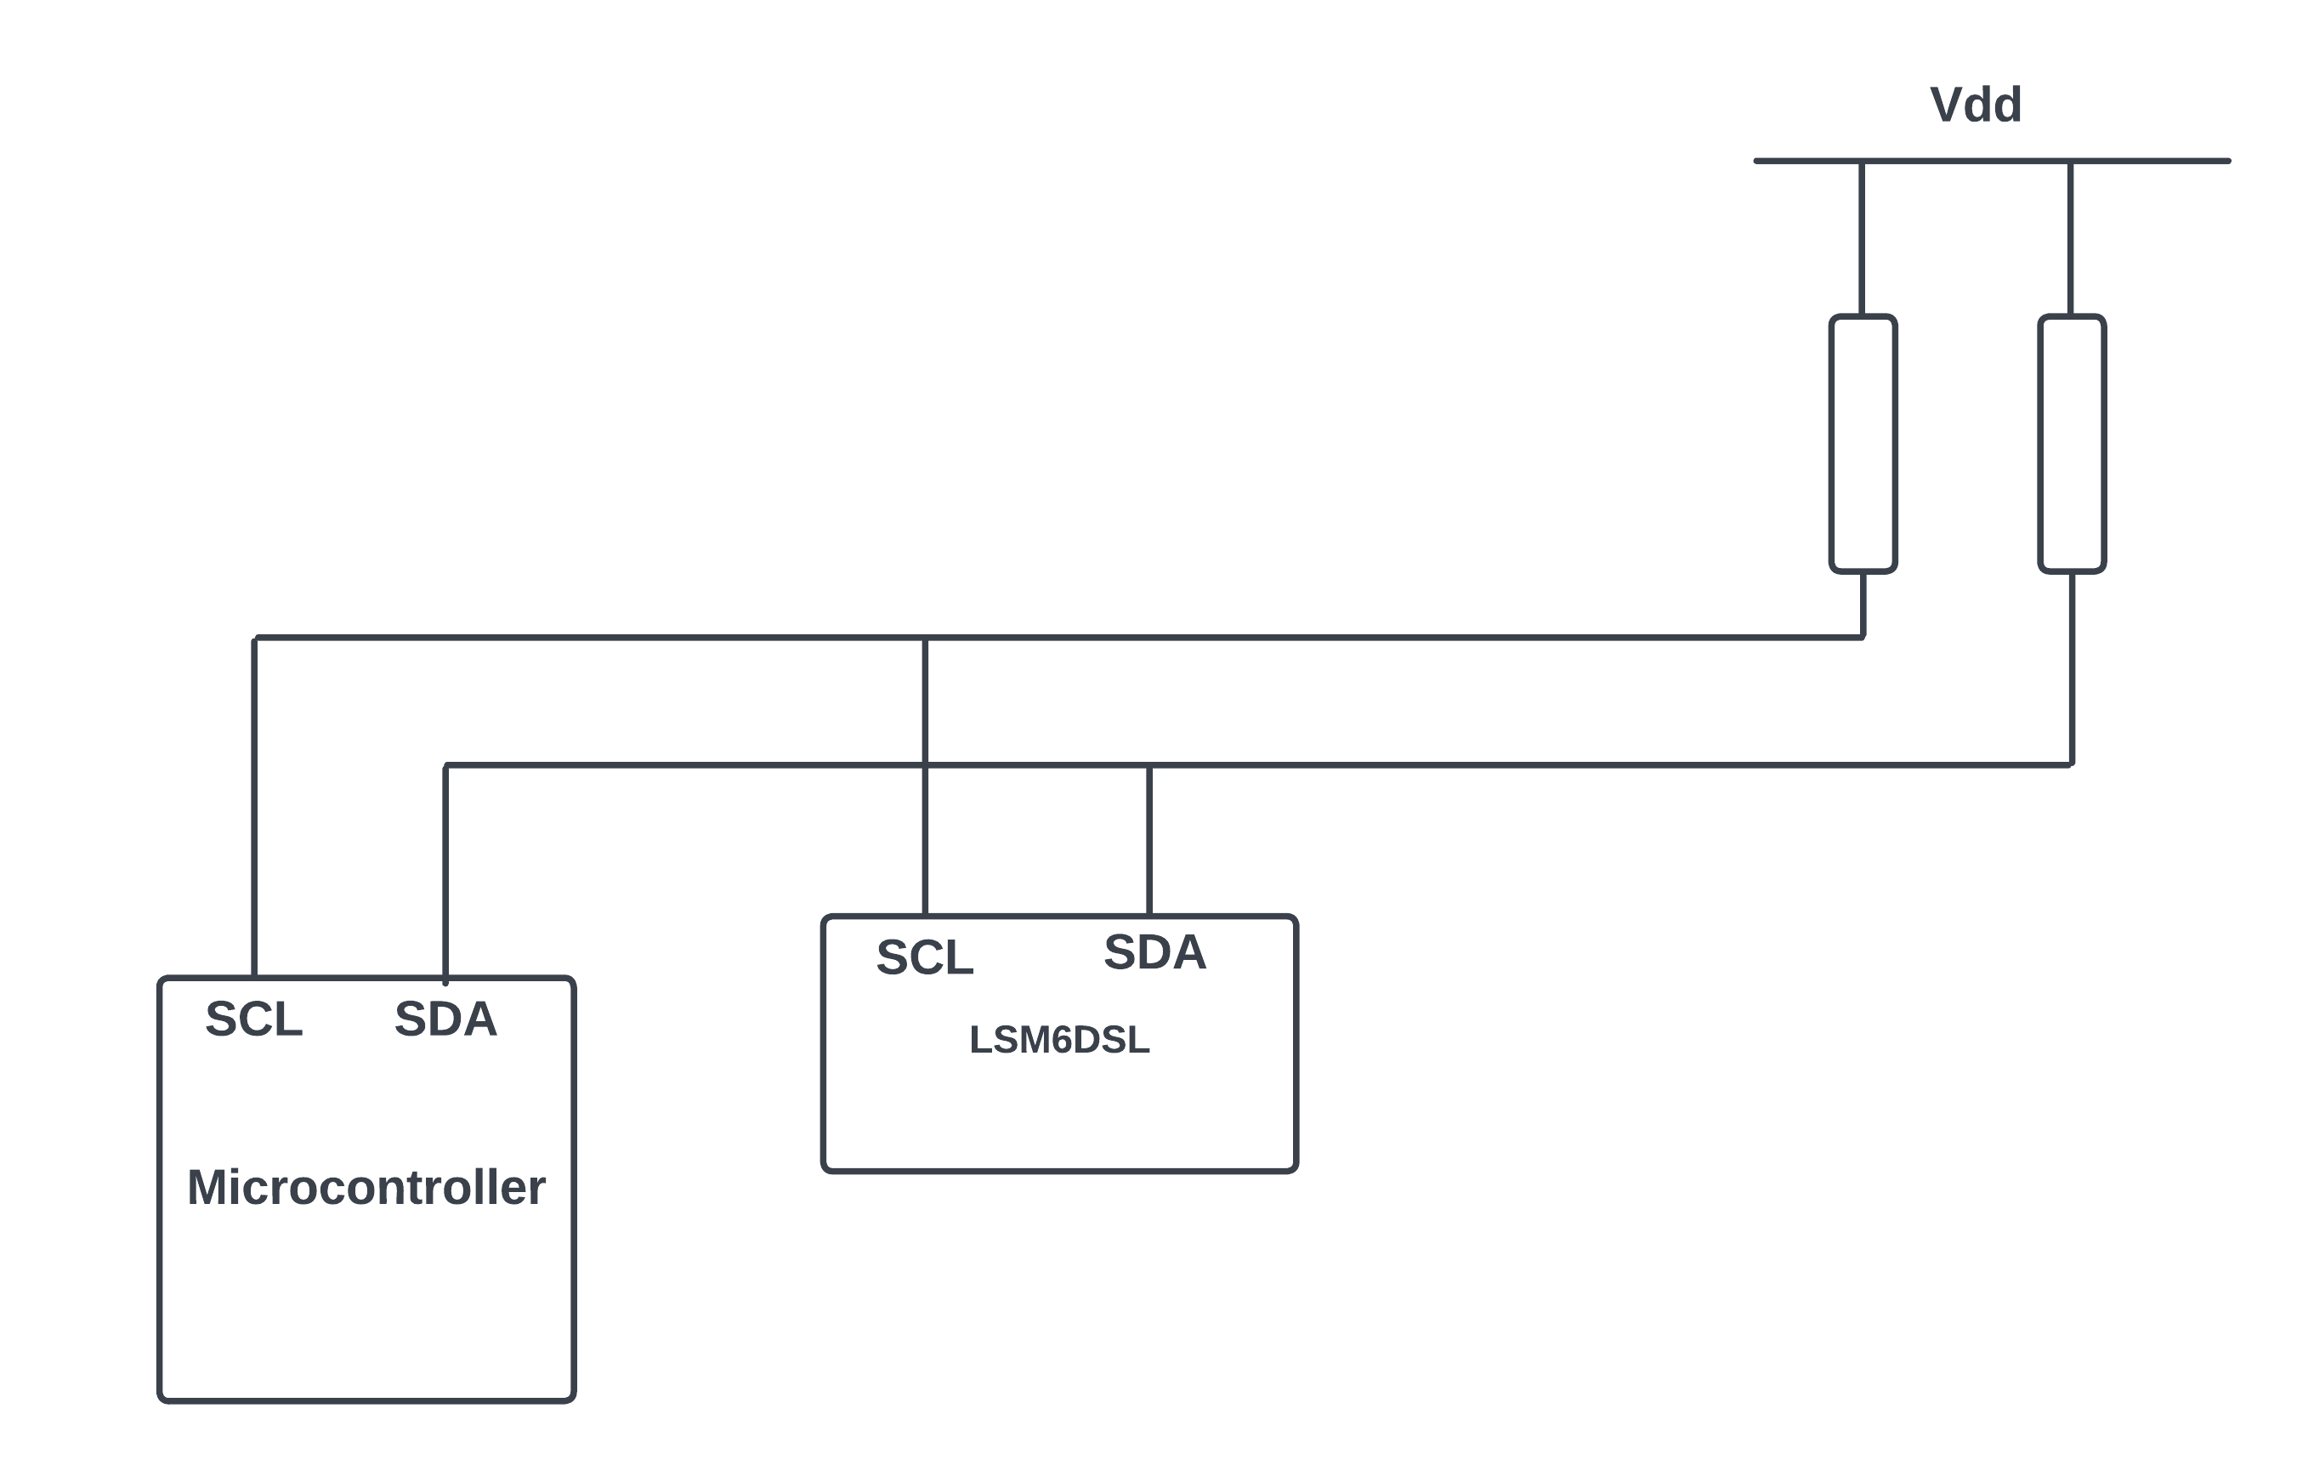
PROTOCOLS USED: I2C
I2C, or Inter-Integrated Circuit, is a straightforward bidirectional communication protocol utilizing only two wires, SCL (Serial Clock) and SDA (Serial Data). This protocol efficiently manages communication between microcontrollers and other devices connected to the I2C bus.
While this project has connected a single sensor to the I2C bus, but the I2C bus allows for the interfacing of multiple devices using just two wires.

Slide 8
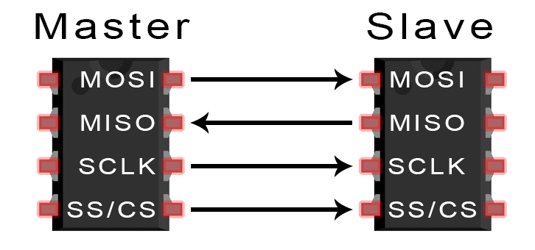
PROTOCOLS USED: SPI
SPI, or Serial Peripheral Interface, serves as a communication protocol for interacting with external devices. This protocol offers versatile options, supporting half duplex, full duplex, and simplex synchronous serial communication with external devices.
SPI enables high-speed, bidirectional communication between a master device and multiple peripheral devices, allowing efficient data exchange in a synchronized manner.

Slide 9
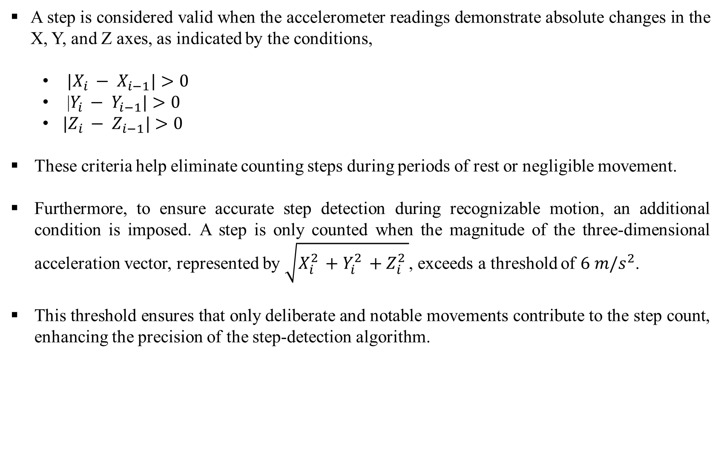
NO.OF STEPS CALCULATED
A step is considered valid when the accelerometer readings demonstrate absolute changes in the X, Y, and Z axes, as indicated by the conditions,
${|X}_{i }− X_{i−1}|>0$
|$Y_{i }− Y_{i−1}|>0$
${|Z}_{i }− Z_{i−1}|>0$
These criteria help eliminate counting steps during periods of rest or negligible movement.
Furthermore, to ensure accurate step detection during recognizable motion, an additional condition is imposed. A step is only counted when the magnitude of the three-dimensional acceleration vector, represented by $\sqrt{X_{i}^{2 }+Y_{i}^{2 }+Z_{i}^{2 }}$, exceeds a threshold of $6 m/s^{2}$.
This threshold ensures that only deliberate and notable movements contribute to the step count, enhancing the precision of the step-detection algorithm.

Slide 10
Other Estimations
Distance covered = stride * number of steps
assume that (stride = height * 0.415)
Calorie burnt = distance covered * weight * MET
(metabolic equivalent of task = 3.5 for walk)
MET indicates how much energy a particular activity consumes compared to being at rest. The MET value for walking is around 3.5. This means that walking at a normal pace requires an energy expenditure 3.5 times higher than the energy expended at rest.

Slide 11
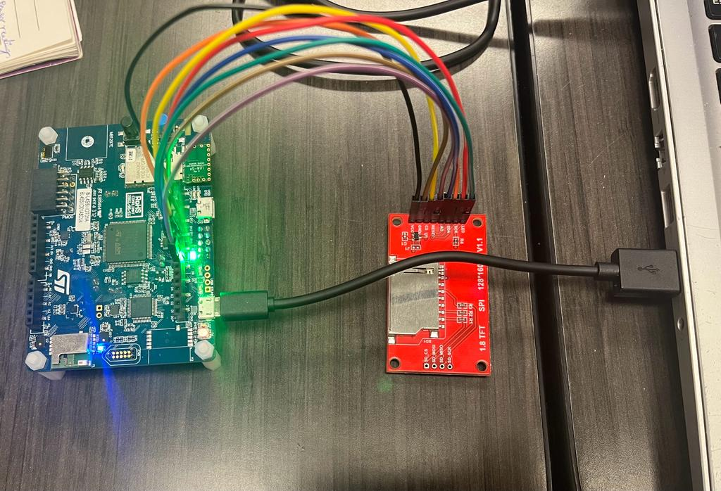
TFT Display
The 1.8-inch TFT LCD Display is interfaced with the microcontroller using SPI protocol. The SCK and SDA pin of display is connected to the SPI_SCK and SPI_MOSI pin of the microcontroller. CS, AO, RESET and LED of display are connected to GPIO Output pin of the microcontroller.
Example for displaying a string:
ST7735_DrawString(140,30,str, Font_7x10, ST7735_WHITE, ST7735_BLACK);
9

Slide 12
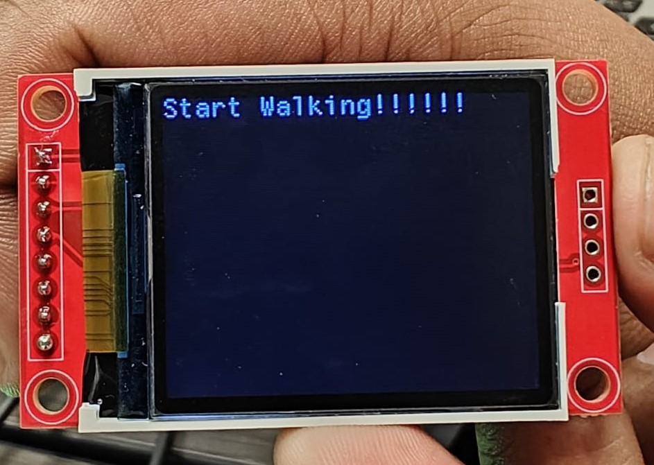
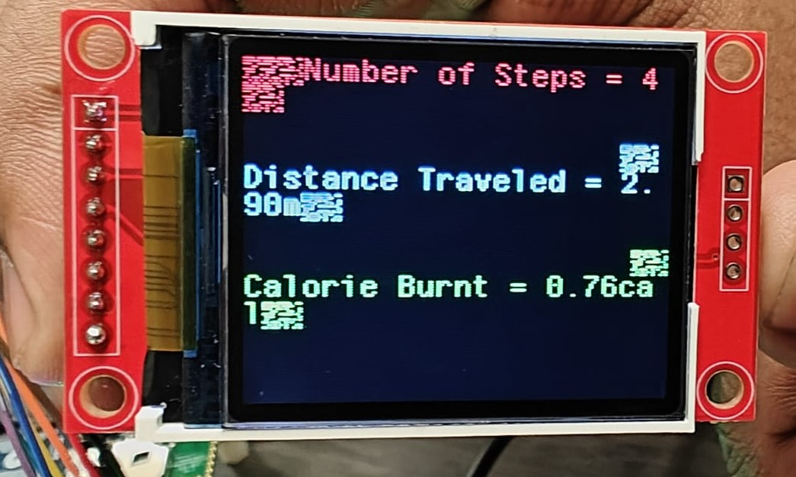
RESULTS(TFT Display):

Slide 13
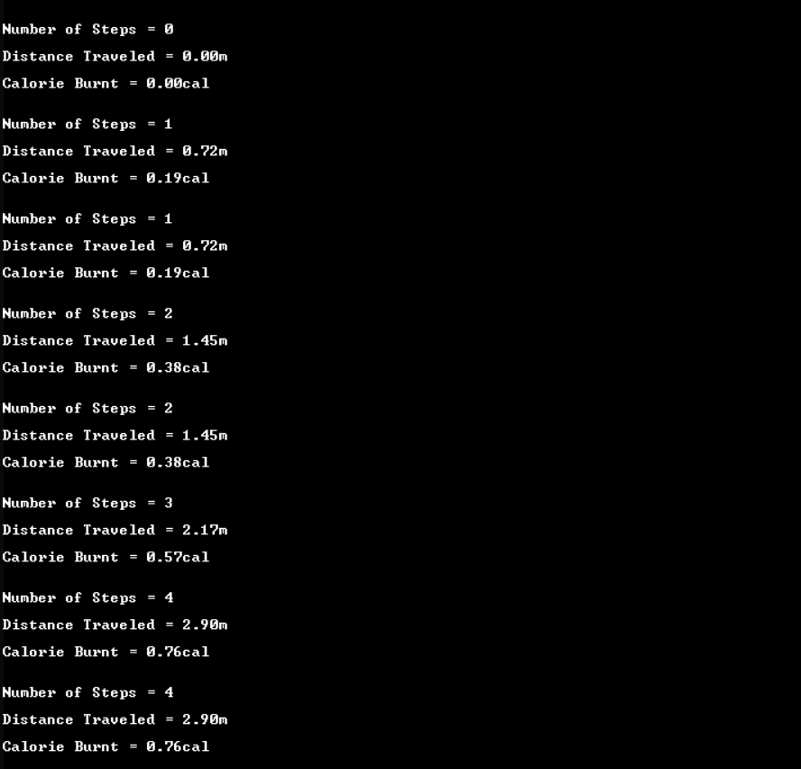
RESULTS(UART Screen):
11

Slide 14
CONCLUSION
Successfully implemented accelerometer-based step detection algorithms, provides users with precise step counts.
Utilize an LCD screen to provide users with a visual interface for viewing step count, calorie estimation, and distance covered.
Provided users with an estimate of calories burned during physical activity, enhancing fitness tracking capabilities.

Slide 15
FUTURE SCOPE
A GPS module can be interfaced with the microcontroller for accurate distance tracking, route mapping, and outdoor activity monitoring.
Data can be synchronized with mobile apps or cloud services for remote monitoring and real-time updates.
Expanding the system with advanced sensors enables automatic activity recognition and comprehensive health monitoring, covering aspects like heart rate, sleep patterns, and blood oxygen levels for a more holistic well-being assessment.

Slide 16
Thank You

